Slide 1


Node.js, REST Api & advanced JS tools
Introduction of node.js, npm/bower, Express, IBM Loopback & other JS tools
by Bhavin Patel

Slide 2
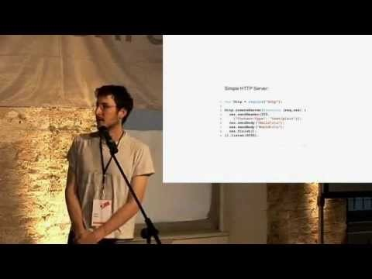

Slide 3
Disclaimer
I'm not a node.js expert by any means , yes that’s true.
I’m not here to force any policy for making node.js official for any of our project.
This is just an informal webinar for node.js and some of it’s best practices which I’ve used in few of my recent projects.
We’re not here to compare node.js with any other frameworks like .NET, Go etc. I’m originally a .NET developer and I still like it but let’s not fight over node vs. .NET ☺
Let’s start …

Slide 4
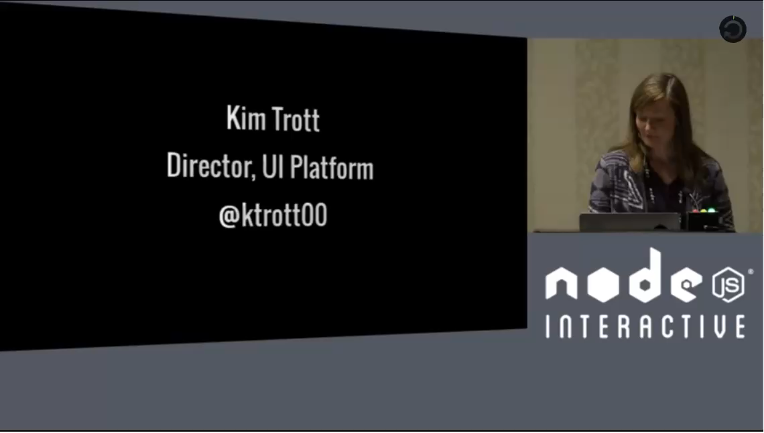

Slide 5

Agenda
Introduction of Node.js
Introduction of Npm and Bower
Introduction of node tools and framworks
Node-tutorial series rundown
CitSearch/Georgia API Overview
Georgia App demo
What is IBM StrongLoop’s Loopback?
Demo of Loopback REST API

Slide 6
Node.JS
What is node.js?
Node.js is a server-side JavaScript environment that uses an asynchronous event-driven model. This allows Node.js to get excellent performance based on the architectures of many Internet applications.
ASYNC i/o framework
Core is C++ on top of V8 (What is V8?) with 40% js and 60% C++
REST behavior in JS
Swiss army knife for network related stuffs
Can handle millions of concurrent connections with minimal overhead (CPU/Memory) on single process (You can always use all core of CPUs using clustering)
Node is command line tool
It uses event-loops of modern JS to implement the non-blocking I/O functionality. (We will see in next slide)
Everything inside node.js runs in a single-thread but latest node >5.1 supports some packages which implements multi threading style code.
Available for all OS and can use any JS editor , even notepad++. (my fav. Is atom and code)
Works well with NoSQL and Relational DBs
Works Well with file system of any OS

Slide 7
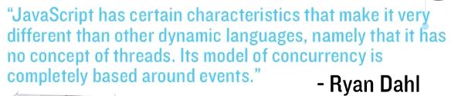
Cont. (what is node?)
Other way to look at it - Node.js is a runtime environment and library for running JS applications outside the browser.
Node.js is mostly used to run real-time server applications, REST Apis, Windows services etc. & shines through its performance using non-blocking i/o and async events.

Slide 8
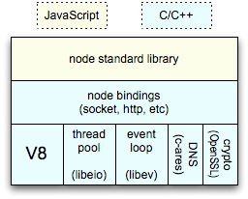
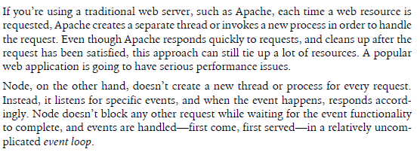
Some idea of an Event-loops
Client
Clients send HTTP requests
to Node.js server
Event loop returns
result to client
Event loop
(main thread)
An Event-loop is woken up by OS,
passes request and response objects
to the thread-pool
Long-running jobs run
on worker threads
Response is sent
back to main thread
via callback
C++ Threadpool
(worker threads)

Slide 9
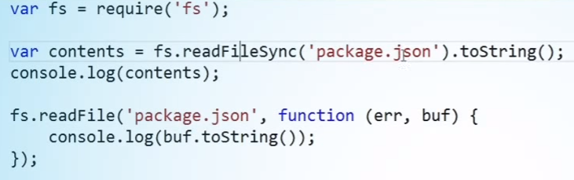
Blocking I/O or Sync
var fs = require(‘fs’);
var contents = fs.readFileSync(‘package.json’).toString();
console.log(contents);
Note: Node’s event loop is basically like JS and running on single thread so if your event or code is blocking some tasks, whole program will be holding till you resolve that sync task.
So good practice anyways in node world is use everything ASYNC or Q-Promise based architecture.

Slide 10
Some theory on non-blocking I/O
Traditional I/O
var result = db.query(“select x from table_Y”);
doSomethingWith(result); //wait for result!
doSomethingWithOutResult(); //execution is blocked!
Non-traditional, Non-blocking I/O
db.query(“select x from table_Y”,function (result){
doSomethingWith(result); //wait for result!
});
doSomethingWithOutResult(); //executes without any delay!

Slide 11
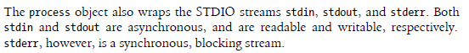
The Node Core
Node global objects, such as global, process, Buffer objects
E.g > console.log(global) //it’s like windows object in browser world
The timer methods, such as setTimeout, clearTimeout, setInterval & clearInterval
Servers, Sockets and Streams objects
Node inheritance object, such as Utilities object
The EventEmitter object and events

Slide 12
Node.js Scaling / Child_process
Your OS provide access to a great deal of functionality, but they are mostly accessible via command line. It would be nice to be able to access this functionality from a Node application. That’s where chile_process come in.
As Node.js runs in a single thread mode but it uses an event-driven paradigm to handle concurrency. It also facilitates creation of child processes to leverage parallel processing on multi-core cpu based systems.
Child processes always have three streams child.stdin, child.stdout, andchild.stderr which may be shared with the stdio streams of the parent process.
Node provides child_process module which has following three major ways to create child process.
exec - child_process.exec method runs a command in a shell/console and buffers the output.
spawn - child_process.spawn launches a new process with a given command
fork - The child_process.fork method is a special case of the spawn() to create child processes.

Slide 13
What can you do with node.js? (What –not?)
Create Servers like http, TCP, DNS, Static FTP.
var http=require(‘http’);
var server = http.createServer(function(req,res){
res.writeHead(200,{“content-type”:”text/plain”});
res.end(“Hello Node.js”);
}).listen(8000);
Create REST API
Create Web Chat Application or any realtime two–way communication based web site. (e.g new Hangout is uses node 4.5) – using Meteor / Socket.io
Create Online games, Collaboration tools etc.
Create native mobile apps (using IONIC, Nativescript, Cordova, Phonegap)
Create Desktop apps (using Electron, nw.js) – We are doing it for Georgia
IoT projects using Arduino & Raspberry Pi
And list just go on and on…..

Slide 14
One technology, all platforms
Node.js brings a way so that JS developers now can develop all types of platforms apps like –
Web App
Desktop App (for multi OS)
Hybrid Mobile App
REST Api
Windows services
Crone job tasks
IoT devices and OS
Games development
Real time communication apps

Slide 15
Who are using it?
Walmart has entire billing system written in Node.js
Netflix & eBay uses it as API and content server
Uber’s REST API, Mobile App, Web App – all on top of node.js
Groupon, SAP, Linked it , Microsoft , Paypal, Google, Wordpress and many IT companies.
Azure mobile services from MS is in node.js
And of course we @ CAPS

Slide 16
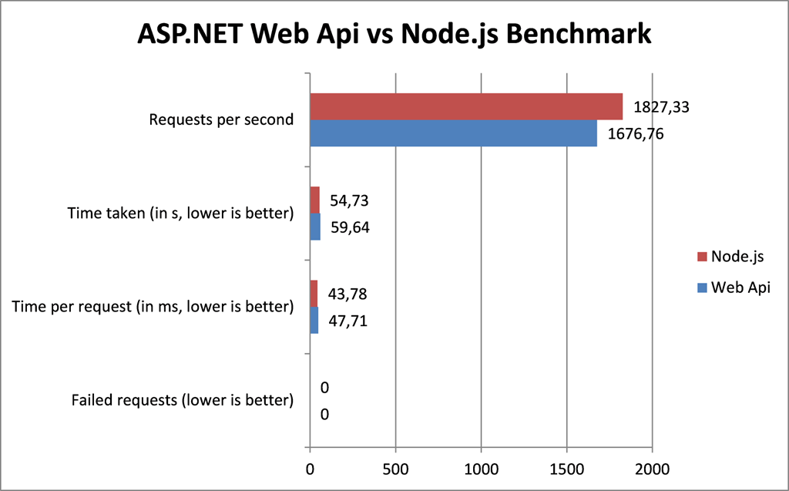
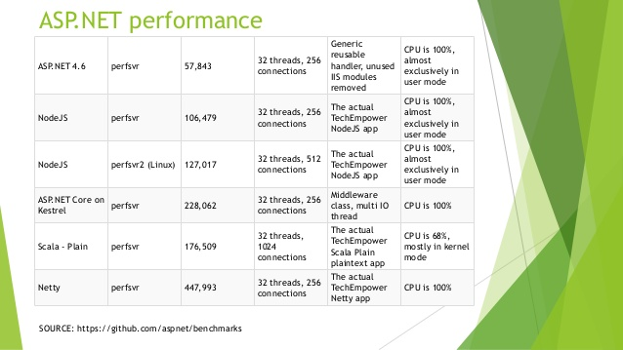

Slide 17

NPM & Bower
npm (it’s now part of node.js)
npm is a NodeJS package manager. As its name would imply, you can use it to install node programs. Also, if you use it in development, it makes it easier to specify and link dependencies.
Every package you will add, it will be list down under package.json file either as dependency or devDependency based on your args.
Some commands-
Npm install –s / -g / --save-d {package}
Npm init
Npm run
Npm update
https://www.npmjs.com/
Bower ?
A package manager for the web
Web sites are made of lots of things — frameworks, libraries, assets, and utilities. Bower manages all these things for you.
bower.io
How to install ?
$ npm install –g bower
$ bower install jquery
There is a library/module for anything

Slide 18



Node frameworks for API, SPA apps
Express.js
Express.js is a Node.js web application server framework, designed for building single-page, multi-page, and hybrid web applications. It is the de facto standard server framework for node.js.
Used by Microsoft, Netflix and Google
Largest and most popular f/w in node community for developing light weight REST API.
http://hapijs.com/community
http://koajs.com/

Slide 19
Popular MVC f/w for Node.js 2016
Express.js
Total.js
Sail.js
Hapi.js (Walmart/sams club f/w)
MEAN.js
Meteor (for real-time app)
Edge.js (if you want to use C# code)
Kraken.js (Paypal F/w)
Loopback.io (IBM f/w)

Slide 20


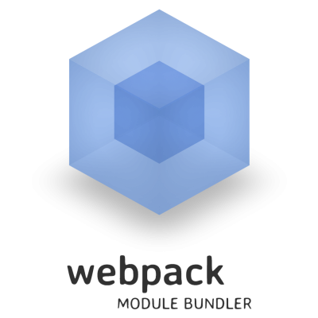
Compilers, Build runners/Task runners with node.js
Gulp
Gulp is a task/build runner for development. It allows you to do a lot of stuff within your development workflow. You can compile sass files, uglify and compress js files and much more. The kicker for gulp is that its a streaming build system which doesn't write temp files. It's like Pipes in bash.
Grunt
Grunt is a task-based command line build tool for JavaScript projects.
Here’s the idea: when working on a JavaScript project, there are a bunch of things you’ll want to do regularly. Like what, you ask? Well, like concatenating given files, running JSHint on your code, running tests, or minifying your scripts. If you’re pasting your JavaScript into JSHint online, you probably realize that there’s a better way to do it; even if you’re using cat to concatenate files or a command line minifier, it would be nice to have a single, unified set of commands for all those extra tasks, that worked for every single JavaScript project, right?
That’s what Grunt aims to be. It has a bunch of built-in tasks that will get you pretty far, with the ability to build your own plugins and scripts that extend the basic functionality.
WebPacks
webpack is a module bundler. webpack takes modules with dependencies and generates static assets representing those modules. As websites are evolving into web apps they are relying more and more on JavaScipt.

Slide 21
Quick catch-up demo
How to start?
Express setup
Basic API knowledge (Ch-1 to 4)
Live reload using nodemon
Express Router (Ch-5)
Setup basic Express based API using mongo db (ch-6)
Setup Winston logger (ch-7)
Setup Access Morgan logger (ch-8)
Setup Clustering in node (ch-9)
Serving html (ch-10)
Working with local auth, passport.js & mongodb, EJS templates(ch-11)
Working with JWT auth (ch-12)

Slide 22
Best Practices to follow all time in node.js
Define routes/controller separately and DI/export them as module
Use of access log using morgan
Use of event/error log using Winston
Use of pre-commit: linting – jslint/eslint/tslint
Use of pre-compiler like webpack or gulp
Use of live-reload server
Use of node environment NODE_ENV
Use of authentication to secure API
Use of try-catch
Use of q-promise

Slide 23
Cont. (Best practices for node.js)
Always Use Asynchronous Methods
Never require Modules Inside of Functions
Always use packages in separate files (e.g. citsearch api)
Validate that Callbacks are Callable
Always Check for “error” in Callbacks
Use module.exports not just exports
Use JSDoc
Use a Process Manager like upstart, forever, or pm2

Slide 24
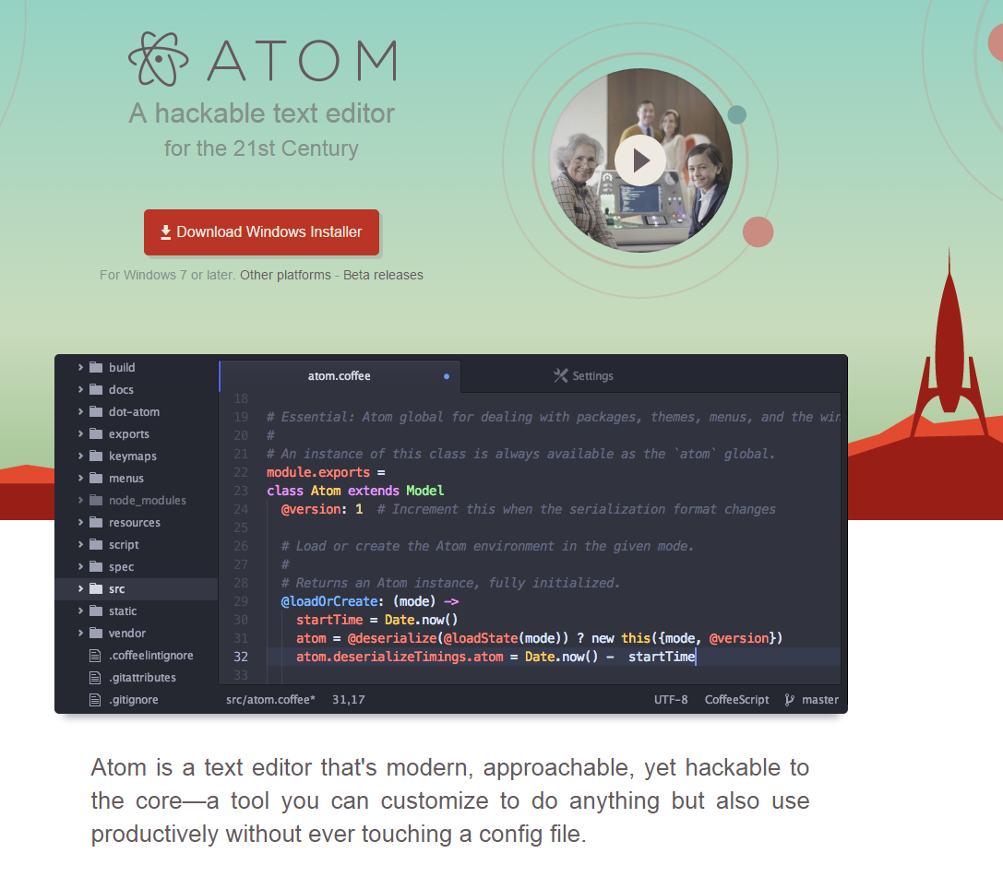
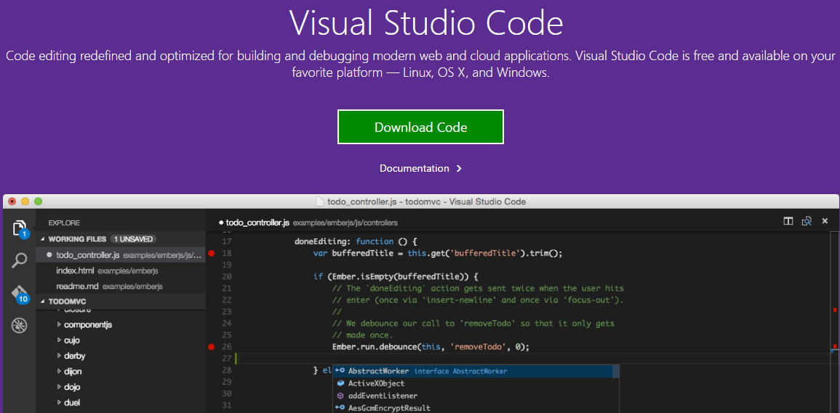
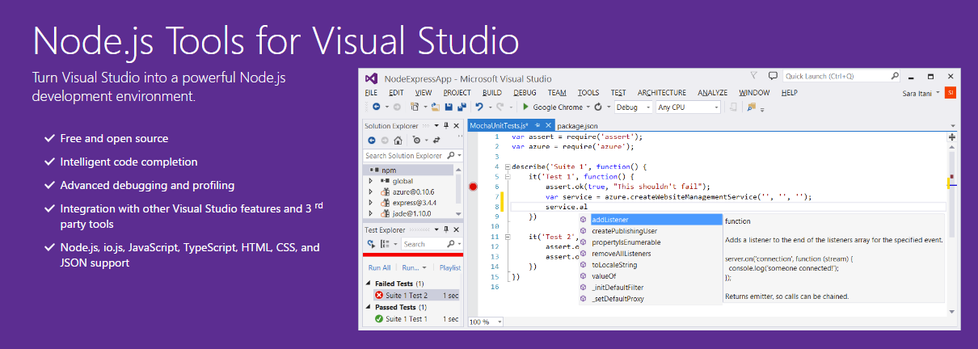
Demo
Arkansas CitSearch REST API

Slide 25

Automated REST API Development using IBM’s Loopback.io
IBM was following Express.js for a while for their cloud and IoT solutions and then decided to write wrapper framework on top of Express.js which generated REST Api automatically based on given DB Settings.
Visit Url- Loopback.io
I’ve compiled curated list of my work and .pdf is available here

Slide 26
Why Loopback.io?
Quickly create dynamic end-to-end REST APIs.
Connect devices and browsers to data and services.
Use Android, iOS, and AngularJS SDKs to easily create client apps.
Add-on components for push, file management, 3rd-party login, and geolocation.
Use StrongLoop Arc to visually edit, deploy, and monitor LoopBack apps.
StrongLoop API Gateway acts an intermediary between API consumers (clients) and API providers to externalize, secure, and manage APIs.
Runs on-premises or in the cloud
Has secure Authentication with JWT, Principal, Authorization and Permisssions
Can extends API with custom methods
Allows proper q-promise based structure
Allows proper try-catch, logs, transactions automatically to each API Routes
Define relationships between models
Supports Environment-specific configuration e.g. PROD, LOCAL, ALPHA, BETA etc

Slide 27
Cont. Why Loopback.io
Enable /Disable stacktrace for debugging
Enable /Disable API Explorer (Automated Website for API Documentation and Testing) using Swagger UI
Supports Versioning of an API
Supports in built Encryption using Bcrypt
Supports Push Notifications for ios and Android
Supports third party plugins for authentication like Google, Twitter, Facebook, Github logins
Supports calling existing SOAP webservices and even extending them in new Node Rest API (Basically convert old soap based ws to Rest API using loopback)
Front-End Tools Compatibility-
Angular 1.X / Angular 2.0
Jquery / Jquery Mobile
Ionic 1 / Ionic 2
React JS
Electron / nw.js(node-webkit)

Slide 28
Demo
Loopback’s demo using Arkansas’s central error DB “Elmah” and updater DB “UserMachineMappings”.
Demo of inbuilt authentication
Configuration of a DB
It can connect and communicate with all popular DBs -
https://docs.strongloop.com/display/public/LB/Connecting+models+to+data+sources

Slide 29
Steps for demo
$npm install –g strongloop
$slc loopback
$slc run
$npm install –S loopback-connector-mssql
Npm install –S tracer (for console.log with colors)
Npm install –S node-fs-extra
Node .\server\model.scripter.js
Register model to REST api in model.config.json
Slc loopback:acl
Select model
All methods & properties
All access types
Any unauthenticated users
Deny Access
Intro – strongloop pm and strongloop arc (https://strongloop.com/node-js/arc/)

Slide 30
Some of the popular design patterns for node.js
The Reactor Pattern
The Callback Pattern
The Observer Pattern

Slide 31
Resources
Basic Idea
Node @ Netflix
4 Hrs long MVA Webcast
Awesome-node
Awesome-Npm
Awesome-electron
4 Hrs of MEAN Development
Express.js Basics
Comparing Node frameworks
Node from start to end (part -1)
Node from start to end (part -2)
Node.js crash course for .NET developers
Code-Maven Node.js
Nodejitsu

Slide 32
Thank you
Further information and articles -
Advanced Web Collection
.NET Information Collection
IoT Collection
Hybrid & Native App Development
WordPress Blog
bhavin.patel@ua.edu

Slide 33


Q & A

